Slide 1

Vehicle Insurance Prediction
BUAN6337 (Group 9)
Instructor Dr. Tongil Kim
Guruprasad Annadurai | Rohith Rajashekharaiah |
Kruthika Natarajan Nirmala | Madhu Prakash |
Durgalakshmi Sundararaman | Xiao Wu

Slide 2
Will an existing health insurance policy holder buy a vehicle insurance?
Insurance is a costly affair. We always think more than twice before shelling out money.
Our client, an Insurance company, has been providing Health Insurance to its customers and now they need our help in building a model to predict whether the existing health insurance policyholders (customers) from past year will also be interested in Vehicle Insurance provided by the company.
Identifying these customers help create customer segments and targets each segment with appropriate marketing strategies that can convince the customer to buy the vehicle insurance
In order to predict, whether the customer would be interested in Vehicle insurance, we have information about demographics (gender, age, region code type), Vehicles (Vehicle Age, Damage), Policy (Premium, sourcing channel)
Data Source: https://www.kaggle.com/anmolkumar/health-insurance-cross-sell-prediction?select=train.csv

Slide 3
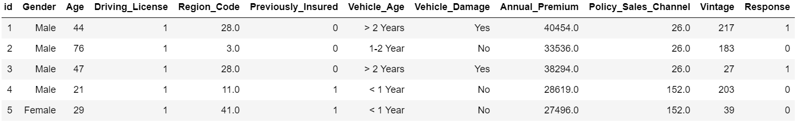
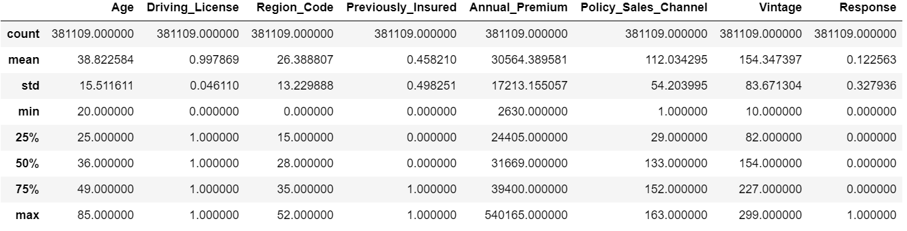
Data Description
Dataset
The dataset has 11 predictor variables, and the target variable is binary with 0 representing not interested and 1 representing an interest in buying vehicle insurance
Predictor variable :
Gender varchar
Age number
Driving_License number
Region_Code number
Previously_Insured number
Vehicle_Age varchar
Vehicle_Damage varchar
Annual_Premium number
Policy_Sales_Channel number
Vintage number
Target Variable
1. Response number
Data Summary

Slide 4
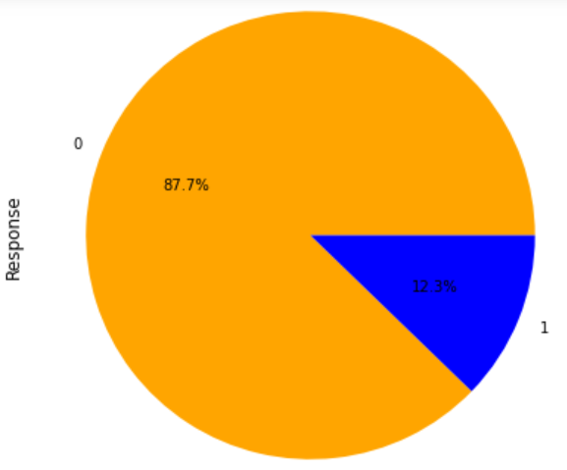
Exploratory Data Analysis
Data is Imbalanced
Upon doing EDA, we see that the dataset is imbalanced with more customers not wanting to buy a vehicle insurance with the health provider.
Only 12.3% of past customers are likely to buy vehicle insurance.
The remaining 87.7% are negligent about their safety and it may also be because they don’t want to go with the same provider.

Slide 5
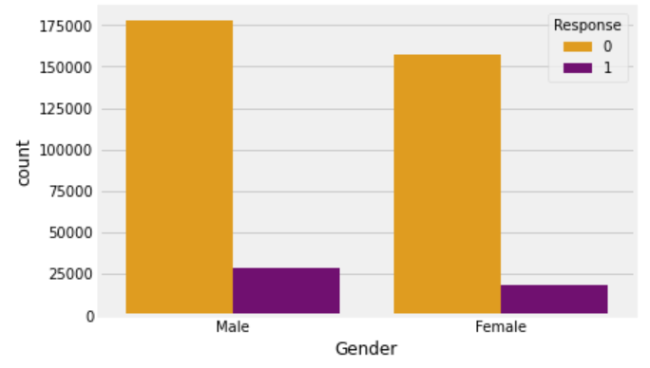
Exploratory Data Analysis
2. Gender variation with Target variable
We see that gender does play a dominant role in determining if an individual will opt for vehicle insurance.
We conclude that more males are interested to buy a vehicle insurance than females.

Slide 6
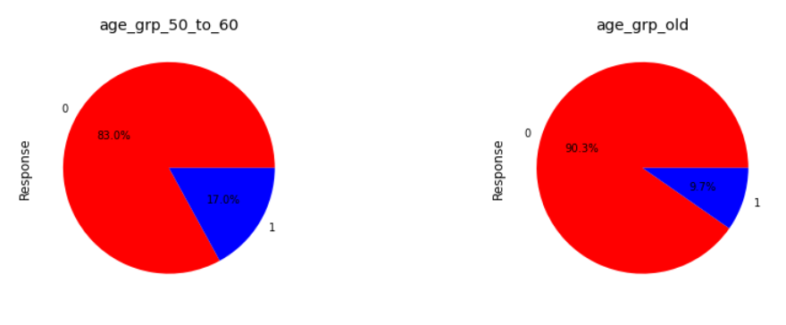
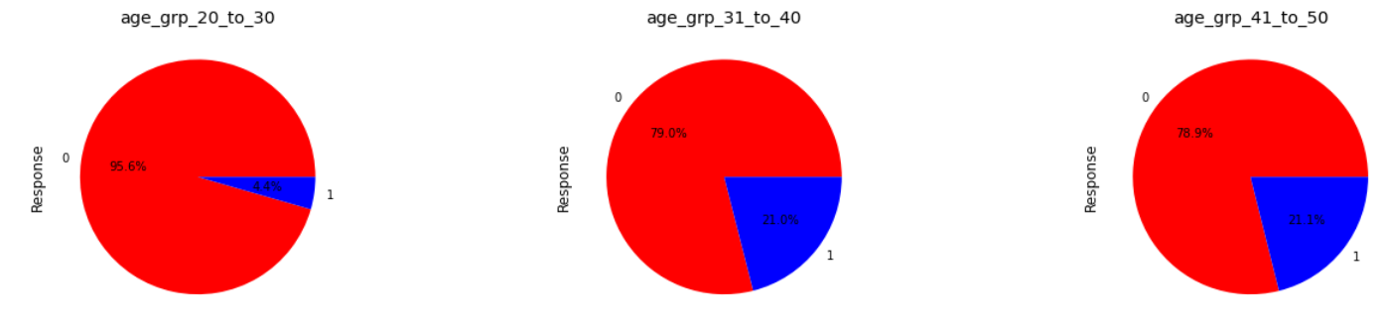
Exploratory Data Analysis
Age and Gender variation with Target variable
Decisions change with age.
Customers of age between 30 to 60 are more likely to buy insurance. This can be attributed to their money control and maturity
Customers of age between 20 to 30 are less likely to buy insurance. This can be because of lack of money control and not so strategized thinking.
Females under age 30 are very less likely to buy insurance

Slide 7
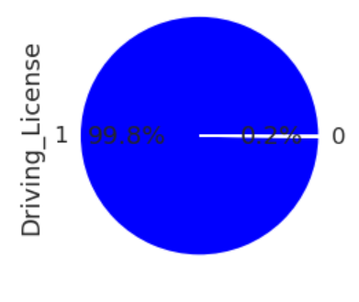
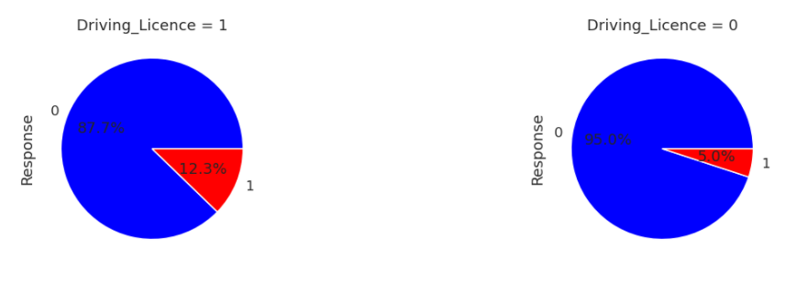
Exploratory Data Analysis
4. Driving License variation with Target variable
Very few customers don't have a Driving License.
Customers with driving license tend to opt for vehicle insurance.
While customers without driving license mostly don’t opt for vehicle insurance.

Slide 8
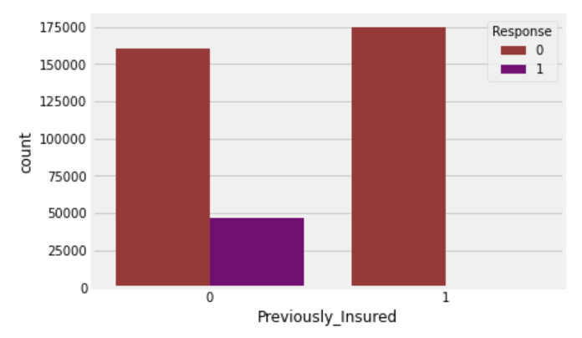
Previously_insured variation with Target variable
Once protected, we always stay protected in most cases.
- Customers who Previously_Insured are very likely to buy Insurance now.
- Customers who didn't Previously_Insured have good chance of buying Insurance.

Slide 9
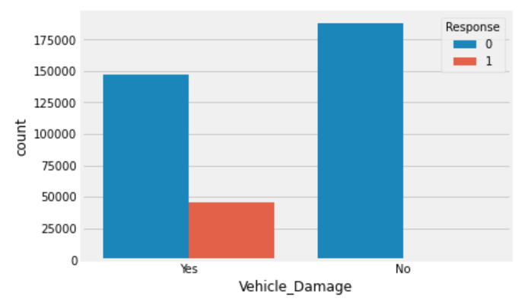
Vehicle_damage variation with Target variable
In our sample people with no vehicle damage is more than people with vehicle damage.
- Customers with Vehicle_Damage are likely to buy insurance
- Customers with non damaged vehicle have least chance (less than 1%) of buying insurance.

Slide 10
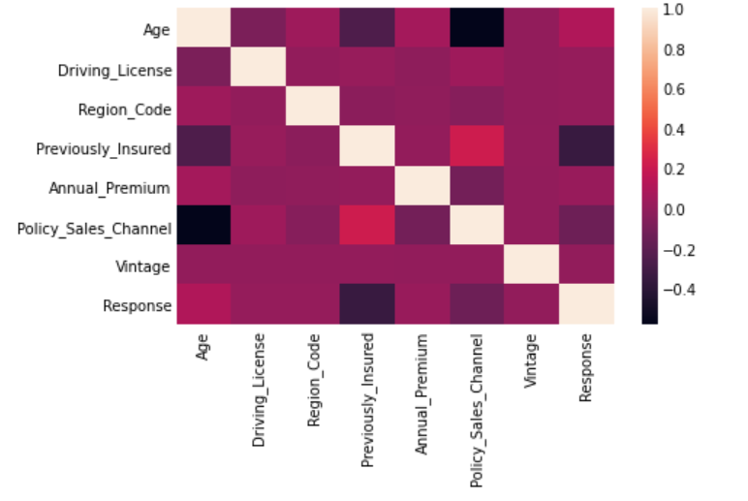
Correlation
Age with sales channel, old people tend to use brokers and agents, young ones use internet
Previously insured is correlated with age. Young people tend to change insurer often
Previously insured with vehicle damage, indeed a lot of policy holders change the insurer while they correspond to big risk
Age and policy sales channel - this is interesting spurious effect. The real underlying effect is relation between age and sales channel, indirectly influencing numbers for age of vehicle

Slide 11
Data Preprocessing
The ID column is dropped since the attribute won’t help in prediction
Categorical variables such as Gender, Vehicle_Damage and Vehicle_Age are label encoded
The dataset is split into training(75%) and testing(25%) dataset to avoid overfitting
Standard scalar method is used to scale the dataset
There are no null values in the dataset

Slide 12
Data Modelling
We have modelled the data using below algorithms to predict the potential customers
Random Forest
Logistic Regression
KNN
Decision Tree
SVM

Slide 13
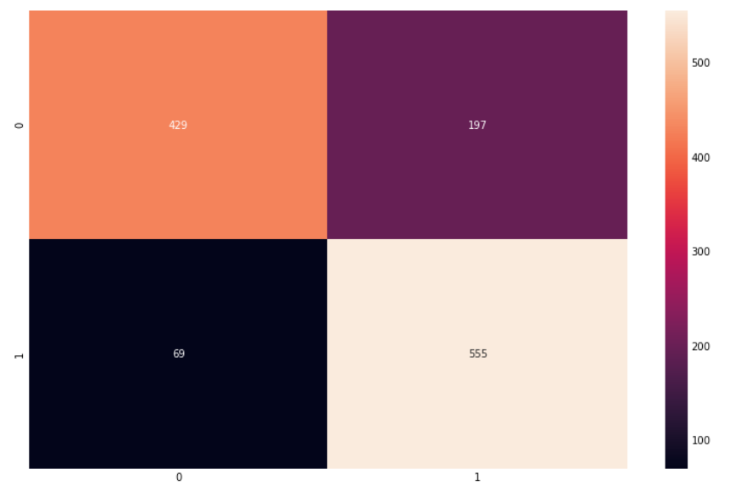
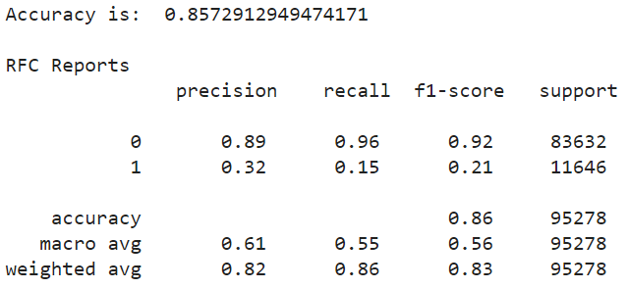
Random Forest
Confusion Matrix
Accuracy: 0.8572
Precision: 0.89
F1-score: 0.92
Model Evaluation

Slide 14
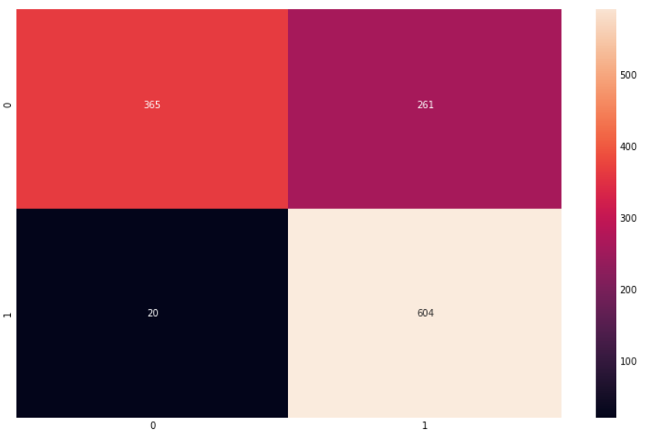
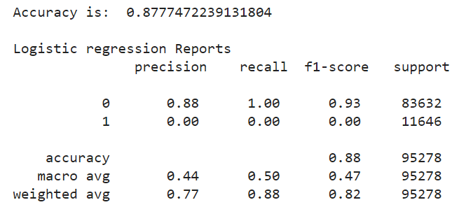
Logistic Regression
Confusion Matrix
Accuracy: 0.8777
Precision: 0.89
F1-score: 0.93
Model Evaluation

Slide 15
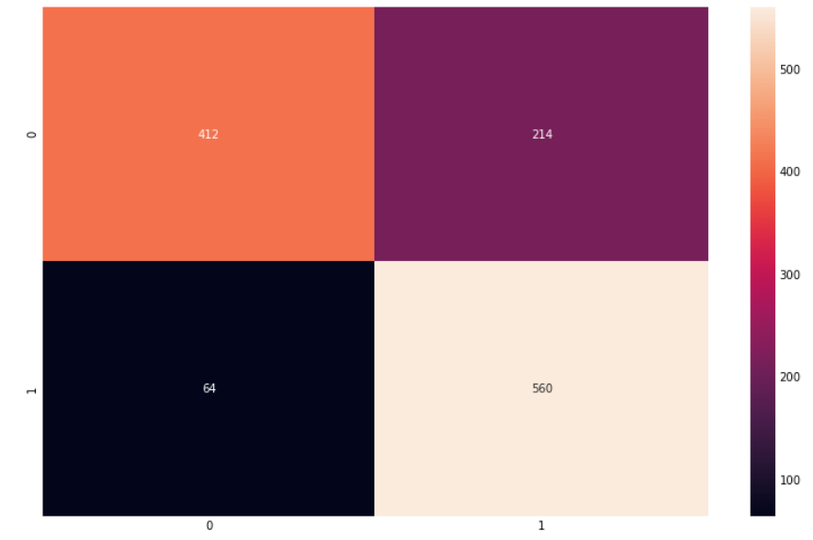
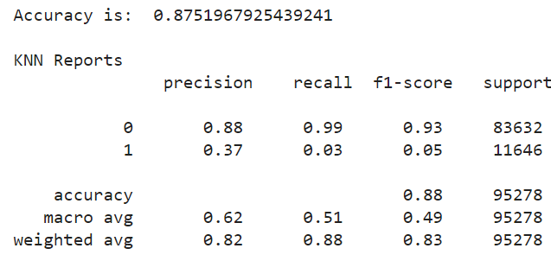
KNN
Confusion Matrix
Accuracy: 0.8751
Precision: 0.88
F1-score: 0.93
Model Evaluation

Slide 16
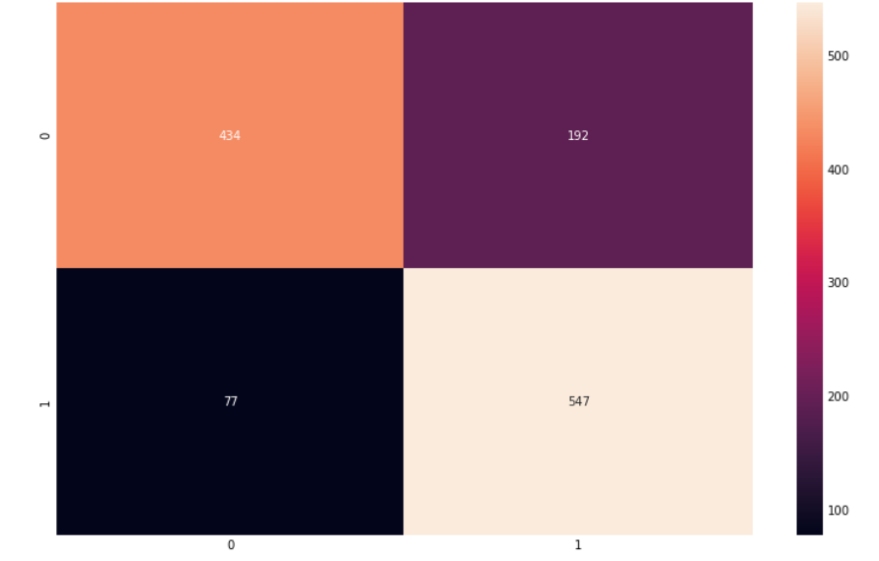
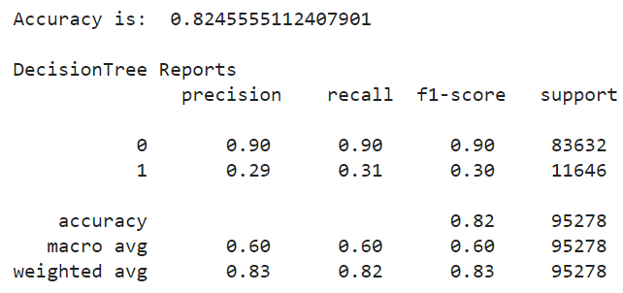
Decision Tree
Confusion Matrix
Accuracy: 0.8245
Precision: 0.90
F1-score: 0.90
Model Evaluation

Slide 17
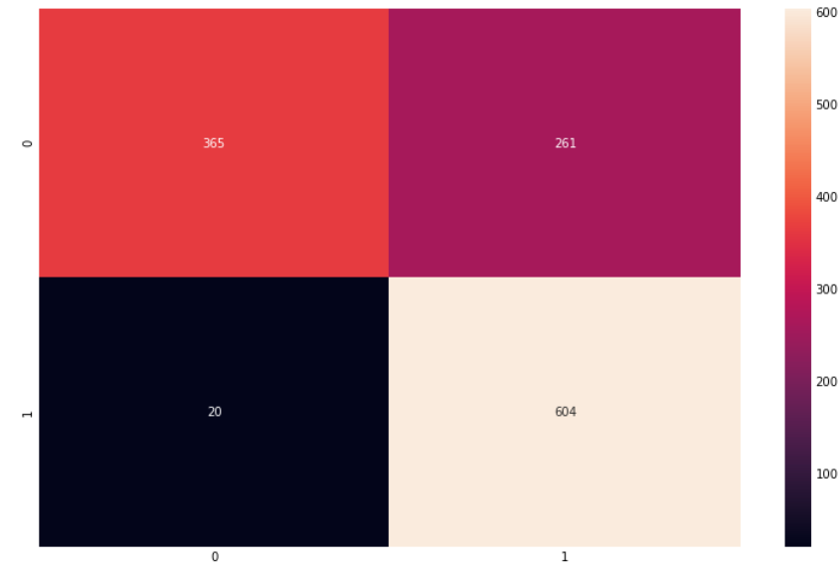
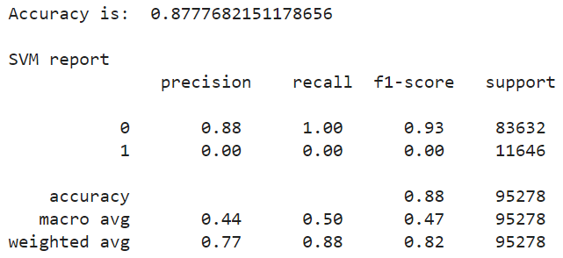
SVM
Confusion Matrix
Accuracy: 0.8777
Precision: 0.88
F1-score: 0.93
Model Evaluation

Slide 18
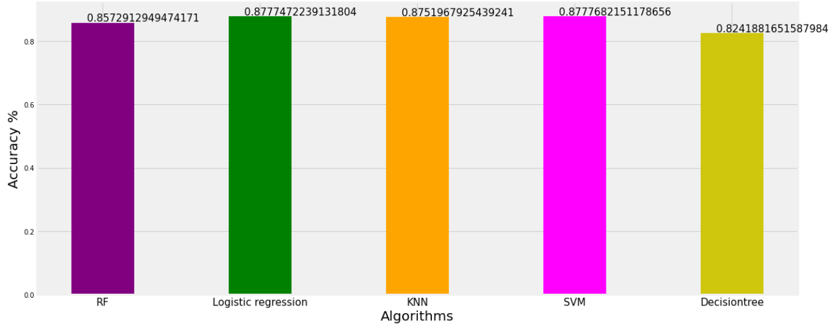
Comparing Accuracies

Slide 19
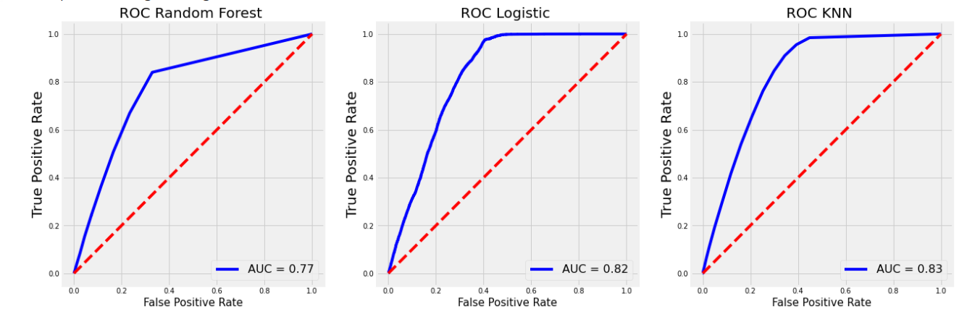
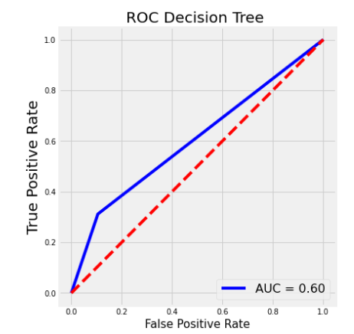
Comparing ROC’s

Slide 20
Conclusion
KNN model is the best model since it has an Accuracy of 0.8751and AUC = 0.83
This model will help to predict the existing health insurance customers who might be willing to buy vehicle insurance as well.
With effective Marketing strategies, We can target those customers with potential offers.

Slide 21
Questions?

